Slide 1
Network Security
Lab 1
Rehab Hosny

Slide 2
What is Network Security?
network security: measures are needed to protect data during their transmission.
network security is somewhat misleading, because virtually all business, government, and academic organizations interconnect their data processing equipment with a collection of interconnected networks. Such a collection is often referred to as an internet, and the term internet security is used.

Slide 3
What are goals of Network Security?
Confidentiality
Integrity
Availability

Slide 4
Confidentiality
Only the sender and intended receiver should be able to understand the contents of the transmitted message. Because eavesdroppers may intercept the message

Slide 5
integrity
Alice and Bob want to ensure that the content of their communication is not altered, either maliciously or by accident, in transit. Extensions to the checksumming techniques that we encountered in reliable transport and data link protocols can be used to provide such message integrity.

Slide 6
Availability
The property of a system or a system resource being accessible and usable upon demand by an authorized system entity, according to performance specifications for the system

Slide 7
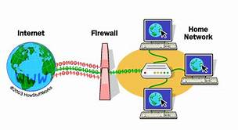

What are types of network security?
1- Firewalls
May be hardware or software
prevent illegal modification/access of internal data.
allow only authorized access to inside network

Slide 8
What are types of network security?(Cont.)
2- Antivirus software
- remove viruses and fix damage.
3- Access control
- prevent unauthorized users from access to network.
4- Data loss prevention

Slide 9
Security Attack
generic types of attacks
passive
Active
Let us introduce Alice and Bob, two people who want to communicate

Slide 10
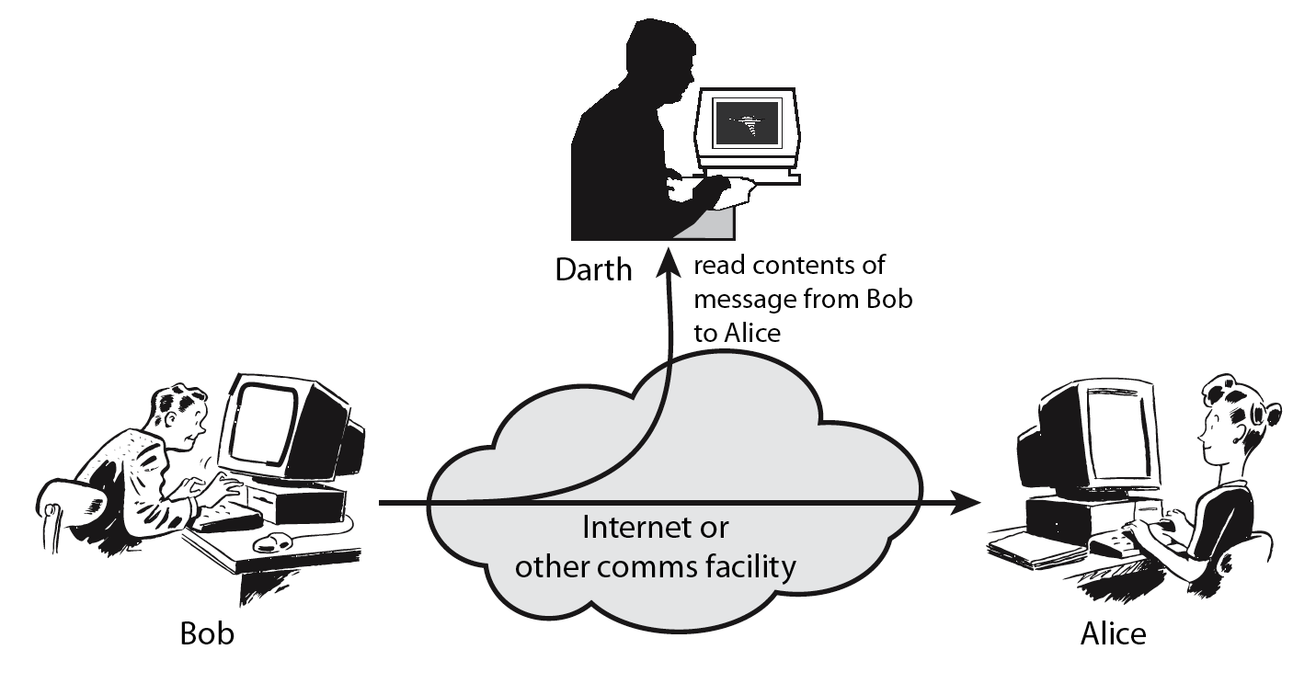
Passive Attacks
passive attack attempts to learn or make use of information from the system but does not affect system resources.
This can take forms such as reading emails, tracking internet use, or using a system's microphone and camera to "spy" on an individual. In a passive attack, the intruder/hacker does not attempt to alter the system or change data.

Slide 11
Types of Passive attacks
Types of Passive attacks are as following:
The release of message content
Traffic analysis

Slide 12
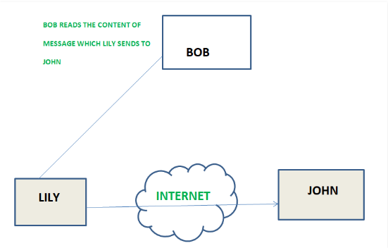
Types of Passive attacks (Cont.)
1. The release of message content Telephonic conversation, an electronic mail message or a transferred file may contain sensitive or confidential information

Slide 13
Types of Passive attacks (Cont.)
2. Traffic analysis
Suppose that we had a way of masking (encryption) of information, so that the attacker even if captured the message could not extract any information from the message.
The opponent could determine the location and identity of communicating host and could observe the frequency and length of messages being exchanged. This information might be useful in guessing the nature of the communication that was taking place

Slide 14
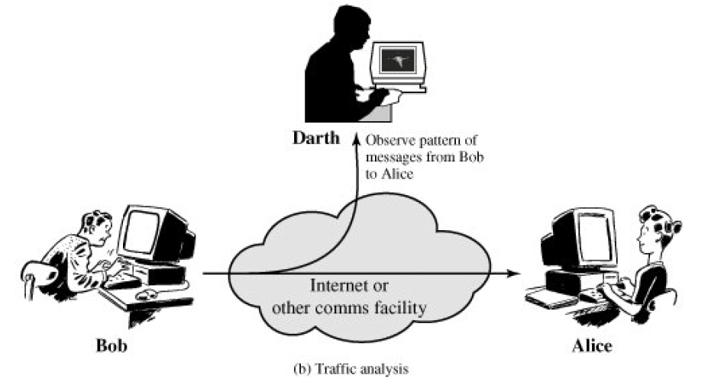
Types of Passive attacks (Cont.)

Slide 15
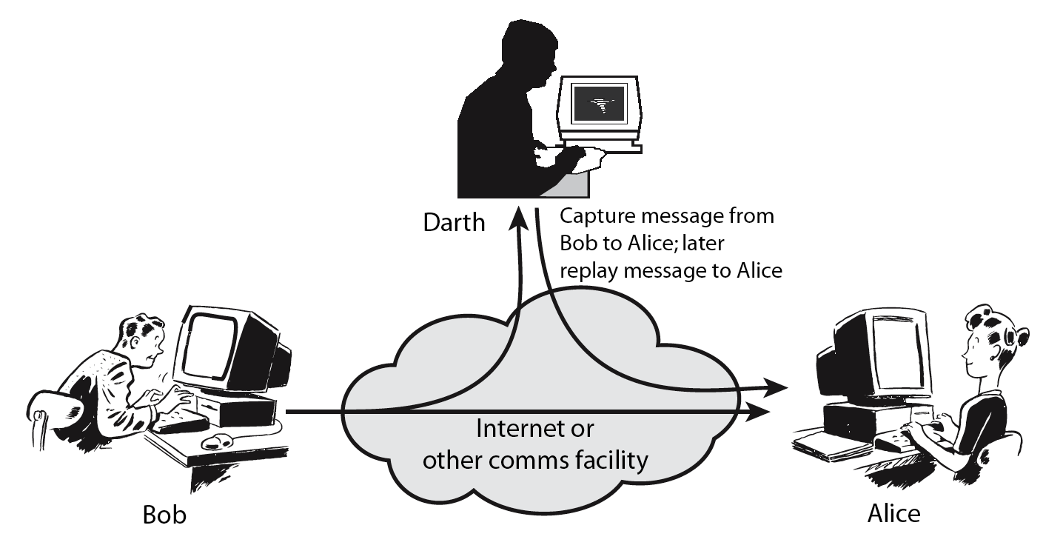
Active Attacks
Involve some modification of the data stream or the creation of a false stream

Slide 16
Types of active attacks
Types of active attacks are as following:
Masquerade
Modification of messages
Repudiation
Replay
Denial of Service

Slide 17
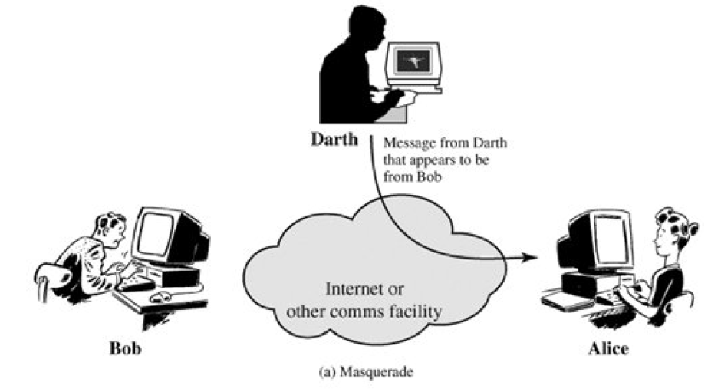
Types of active attacks (Cont.)
Masquerade
Masquerade attack takes place when one entity pretends to be different entity. A Masquerade attack involves one of the other form of active attacks.

Slide 18
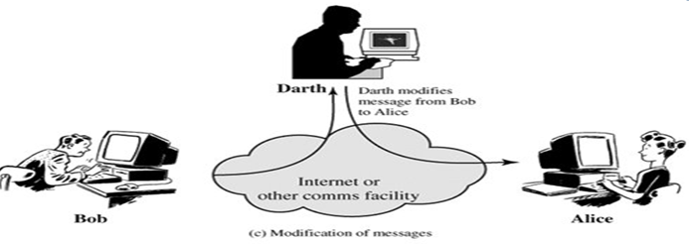
Types of active attacks (Cont.)
2. Modification of messages – It means that some portion of a message is altered or that message is delayed or reordered to produce an unauthorized effect. For example, a message meaning “Allow JOHN to read confidential file X” is modified as “Allow Smith to read confidential file X”.

Slide 19
Types of active attacks (Cont.)
3. Repudiation
This attack is done by either sender or receiver. The sender or receiver can deny later that he/she has send or receive a message. For example, customer ask his Bank “To transfer an amount to someone” and later on the sender(customer) deny that he had made such a request. This is repudiation

Slide 20
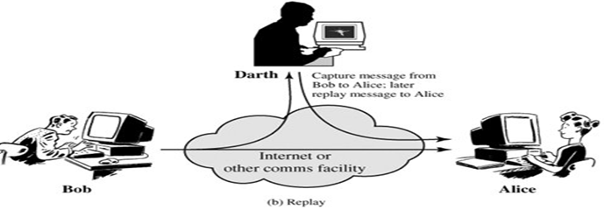
Types of active attacks (Cont.)
4. Replay
It involves the passive capture of a message and its subsequent the transmission to produce an authorized effect.

Slide 21
Types of active attacks (Cont.)
5. Denial of Service – It prevents normal use of communication facilities. This attack may have a specific target. For example, an entity may suppress all messages directed to a particular destination. Another form of service denial is the disruption of an entire network wither by disabling the network or by overloading it by messages so as to degrade performance.

Slide 22
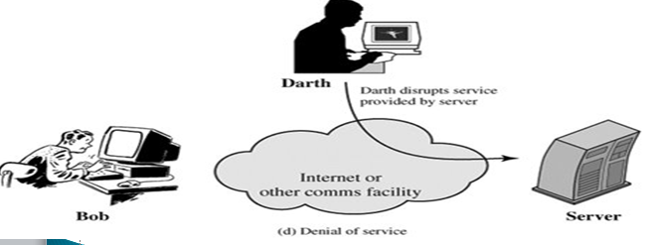
5. Denial of Service

Slide 23

cryptography
Cryptography : The art or science encompassing the principles and methods of transforming an intelligible message into one that is unintelligible, and the retransforming that message back to its original form.
plaintext – the original message
ciphertext – the coded/transformed message

Slide 24
Cryptography (Cont.)
cipher – an algorithm for transforming an intelligible (plain) message into one that is unintelligible (ciphertext) by transposition and/or substitution methods
key – some information used in cipher known only to sender/receiver

Slide 25
Cryptography (Cont.)
Encipher (encode) The process of converting plaintext to cipher text using a cipher and a key
Decipher (decode) the process of converting cipher text back into plaintext using a cipher and a key

Slide 26
Cryptography (Cont.)
Cryptographic systems are generally classified along 3 independent dimensions:
Type of operations used for transforming plain text to cipher text
The way in which the plain text is processed
The number of keys used

Slide 27
1. Type of operations used for transforming plain text to cipher text
All the encryption algorithms are based on two general principles:
substitution, in which each element in the plaintext is mapped into another element.
transposition, in which elements in the plaintext are rearranged.

Slide 28
2. The way in which the plain text is processed
A block cipher processes the input and block of elements at a time, producing output block for each input block.
A stream cipher processes the input elements continuously, producing output element one at a time, as it goes along.

Slide 29
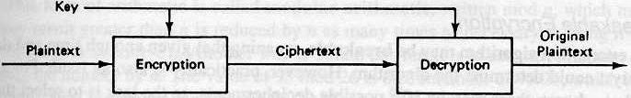
3. The number of keys used
If the sender and receiver uses same key then it is said to be symmetric key (or) single key (or) conventional encryption.

Slide 30
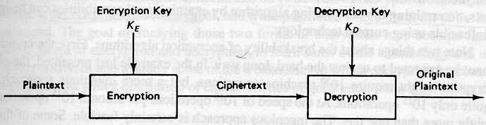
Cryptography (Cont.)
If the sender and receiver use different keys then it is said to be asymmetric key or public key encryption.
public-key crypto: encryption key public, decryption key secret (private)

Slide 31
One Time Pad Cipher
It represents the message as a sequence of 0s and 1s. this can be accomplished by writing all numbers in binary, for example, or by using ASCII.
The key is a random sequence of 0‟s and 1‟s of same length as the message. Once a key is used, it is discarded and never used again.

Slide 32
One Time Pad Cipher (Cont.)
To encrypt message m the sender computes
c := m ⊕ k,
Where ⊕ represents bit-wise exclusive-or.
Decryption is performed by setting
m := c ⊕ k.

Slide 33
Another type of encryption
Key = 3
Which means shift the character 3 times

Slide 34
THANKS

